Slide 1
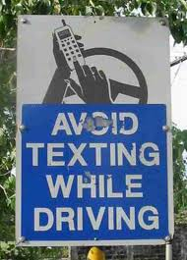
WHILE – DURING - FOR

Slide 2
WHILE = conjunction, followed by a clause
While I was waiting for my husband, I watched TV.
I met my boyfriend while I was at university.
Somebody knocked on the door while I was having a bath.

Slide 3
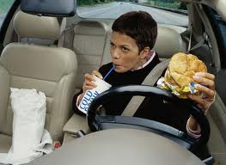
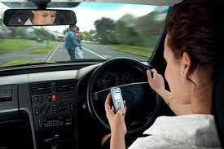
Mary … while …
Susan … while …

Slide 4
DURING = preposition, followed by a noun => at some point in a period of time
The plane landed during the night.
Can I have a few words with you during the break?
During the tennis match the audience was very silent.

Slide 5
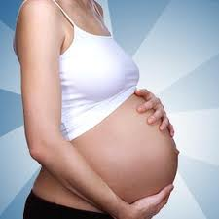
Women …. during ….

Slide 6
FOR = preposition, followed by a noun => how long
The Smiths lived in Birmingham for twenty years.
We stopped working for ten minutes.
We’re going on a ski holiday for two weeks.

Slide 7
How long did you work on your test?
I worked on it for …

