Slide 1
Vocabulary: the weather NH Intermediate p.44
NH

Slide 2
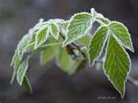
 | adjective | noun | verb

Slide 3
 | adjective | noun | verb
 | It’s sunny. | sun | The sun’s shining.
 | It’s rainy. | rain | It’s raining.
 | It’s snowy. | snow | It’s snowing.
 | It’s windy. | wind | The wind’s blowing.
 | It’s frosty. | frost | It’s freezing.

Slide 4
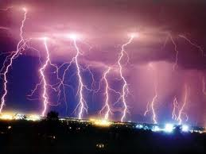
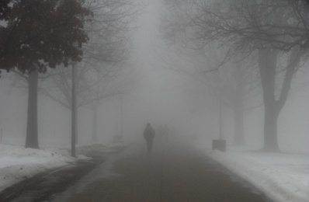
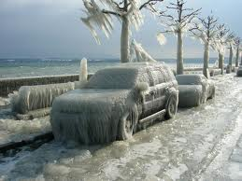
 | adjective | noun

Slide 5
 | adjective | noun
 | It’s cloudy. | cloud
 | It’s stormy. | storm/ thunderstorm
 | It’s foggy. | fog
 | It’s icy. | ice

Slide 6
Ex.2: map of Western Europe
1. | 6.
2. | 7.
3. | 8.
4. | 9.
5. | 10.

Slide 7
Ex.2: map of Western Europe
1. Scotland | 6. Belgium
2. Northern Ireland | 7. France
3. Wales | 8. Spain
4. England | 9. Switzerland
5. Holland | 10. Italy

Slide 8
A. Northern Ireland, Scotland, Scandinavia
weather
temperatures

Slide 9
A. Northern Ireland, Scotland, Scandinavia
weather: chilly | rain snow on the mountains
temperatures | 5° or 6° or even lower

Slide 10
B. England, Wales, Northern France, Belgium, Holland
weather
temperatures

Slide 11
B. England, Wales, Northern France, Belgium, Holland
weather: brighter, with showers | rain, sunshine => spells of sunshine, sunny spells light winds from the south => breeze
temperatures | 8°-15°

Slide 12
C. Southern France, Spain
weather
temperatures

Slide 13
C. Southern France, Spain
weather | clear skies lots of sunshine some clouds strong winds
temperatures | 24° in the far south 18° or 19° elsewhere

Slide 14
D. Switzerland, Northern Italy
weather
temperatures

Slide 15
D. Switzerland, Northern Italy
weather: snow and strong winds | stormy with thunder and lightning 2 inches of rain early morning fog
temperatures | 10°

