Slide 1
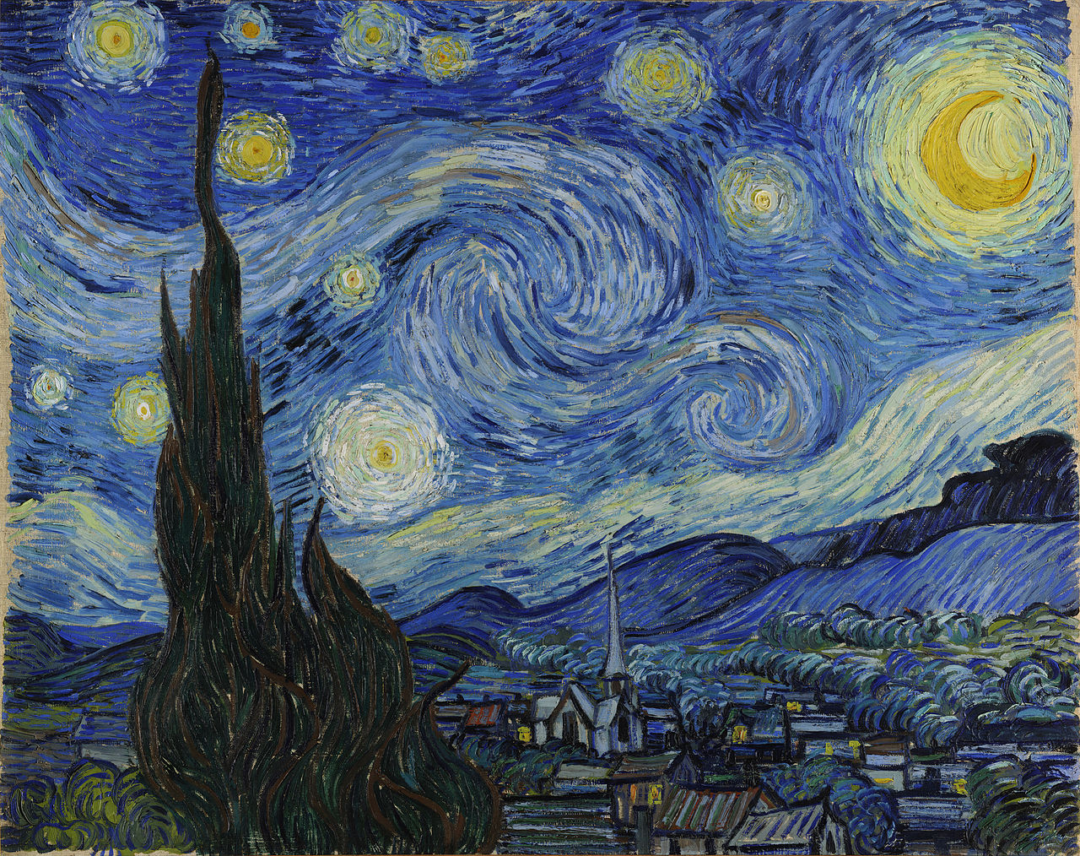

Slide 2
Who’s the painter of this famous work of art?
A. Paul Gauguin
B. Vincent Van Gogh
C. Toulouse Lautrec
D. Edgar Degas

Slide 3
What is the title?
A. Blue Sky
B. The Cypress
C. Starry Night
D. The Sleeping Village

Slide 4
Describe what you see in the painting
Colours?
Buildings?
Composition?
Other elements?
Realistic?
Dreamlike?
Atmosphere?

Slide 5
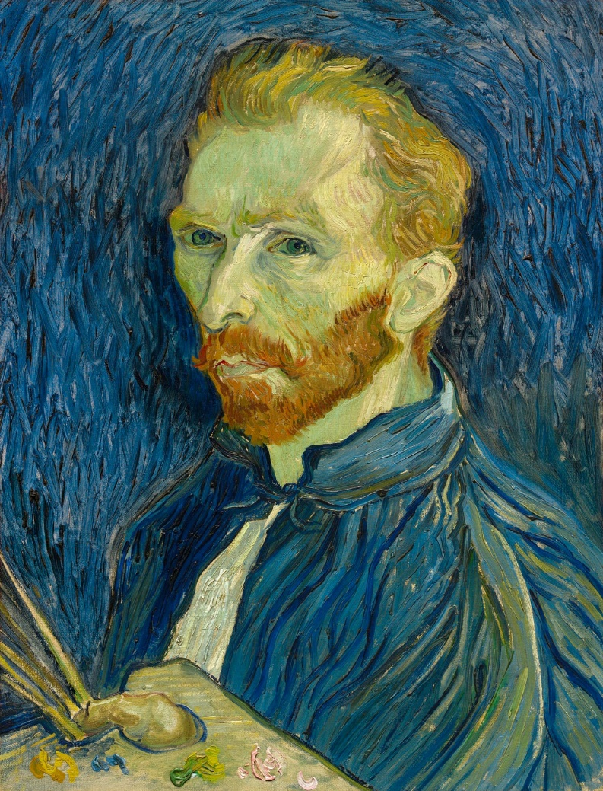
Vincent Van Gogh
1853-1890
Dutch
Lived in the Provence (light!)
Mental problems
Quarrel with Paul Gauguin
“Starry Night”: view from his window in sanatorium in Saint-Rémy

Slide 6
“Vincent” (Starry Starry Night) by Don McLean
http://www.youtube.com/watch?v=oxHnRfhDmrk
Note: most paintings, but not all of them, are by Van Gogh

Slide 7
Starry, starry night Paint your palette blue and gray Look out on a summer's day With eyes that know the darkness in my soul Shadows on the hills Sketch the trees and the daffodils Catch the breeze and the winter chills In colors on the snowy linen land Now I understand What you tried to say to me How you suffered for your sanity How you tried to set them free They did not listen, They did not know how Perhaps they'll listen now

Slide 8
Starry, starry night Flaming flowers that brightly blaze Swirling clouds in violet haze Reflect in Vincent's eyes of china blue Colors changing hue Morning fields of amber grain Weathered faces lined in pain Are soothed beneath the artist's loving hand For they could not love you But still your love was true And when no hope was left insight On that starry, starry night You took your life as lovers often do But I could have told you Vincent This world was never meant for one as beautiful as you

Slide 9
Starry, starry night Portraits hung in empty halls Frameless heads on nameless walls With eyes that watch the world and can't forget Like the strangers that you've met The ragged men in ragged clothes The silver thorn of bloody rose Lie crushed and broken on the virgin snow Now I think I know What you tried to say to me How you suffered for your sanity How you tried to set them free They did not listen they're not listening still Perhaps they never will

Slide 10
Questions
What colours are referred to?
Where do you find descriptions of his paintings?
Who are “them”, “they”?
What contrasts, oppositions do you find in the song?
Can you find a reference to his friendship with Gauguin?
Which line talks about his suicide?

