Slide 1
MODAL VERBS OF POSSIBILITY AND PROBABILITY

Slide 2
1. Present and future
(present infinitive)
You must be tired after such a long day.
might be
could be
You can’t be tired after such a good night.
(continuous infinitive)
She must be working day and night.
might be
could be
She can’t be working very hard.

Slide 3
must/can’t => strong possibility / probability (Dutch : moet / kan niet)
might/could => weaker probability (Dutch : no similar, comparable forms)
in Dutch : misschien
use of perhaps / maybe : sounds very un-English!

Slide 4
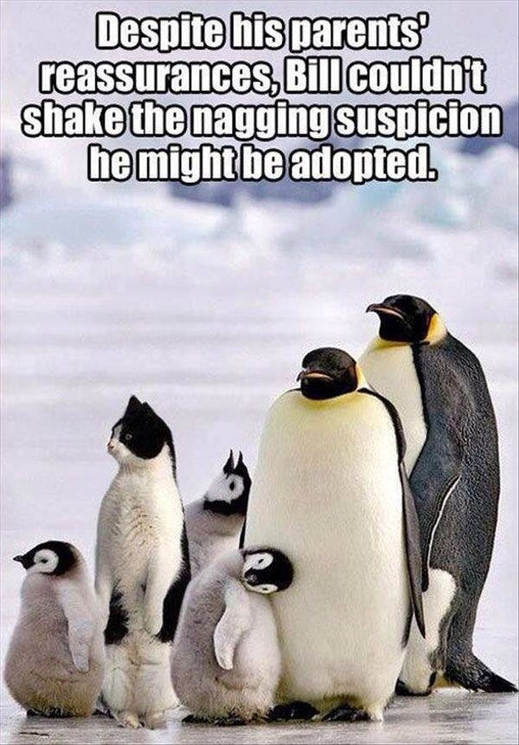

Slide 5
DON’T SAY: | BUT SAY:
Maybe they’ll come. Maybe she failed her test. Perhaps he’s taking a break. Perhaps I left my bag on the train. | They might come. She might/could have failed her test. He could/might be taking a break. I might have left my bag on the train.

Slide 6
2. Past
(perfect infinitive)
She must have been on a holiday.
might have been
could have been
She can’t have been home all summer.
(continuous infinitive)
He must have been joking.
might have been talking to her.
could have been running home.
He can’t have been trying hard to succeed.

Slide 7
3. Asking about possibilities
Do you think he’s married? He might be. But he doesn’t wear a wedding ring.
Do you think the students are ready yet? They may be. At least some of them.
Where do you think he’s from? He can’t be English. He doesn’t speak the language.
What do you think Paul is doing? He must be sleeping. It’s so silent in his room.

Slide 8
