Slide 1
MODAL VERBS OF OBLIGATION AND PERMISSION

Slide 2
Introduction : What are modal verbs?
Modal verbs: can, could, may, might, must, will, would should, ought to
= auxiliary verbs, they help other verbs
= followed by an infinitive
They express attitudes, opinions, judgments. (⬄ facts)
- What’s that? It’s the wind in the chimney. (fact)
- What’s that? It could/may/might/must/can’t be a burglar. (opinion)
They may have several meanings.
- I must study English! (obligation) – You must be hungry. (probability)
- Could you help me? (request) – We could go to the pub. (possibility)
- You may leave now. (permission) – John may come soon. (possibility)

Slide 3
1. Have (got) to
Have to: strong obligation, a general obligation based on a law or the authority of a person => rather impersonal
Form:
I/You/We/They have to wear a blue uniform.
He/She has to be home before 11 p.m.
Do I/you/we/they have to stay at home all night?
Does he/she have to write in English?
I/You/We/They don’t have to speak English.
He/She doesn’t have to stay till 6 p.m.
Have got to (Br. Engl.): more informal
I’ve got to go now. See you!
We’ve got to study hard today.

Slide 4
have to/must vs. don’t have to/mustn’t
Have to and must : often interchangeable
I must be home by midnight. / I have to be home by midnight.
Don’t have to and mustn’t : completely different !
You don’t have to iron your socks. It’s a waste of time.
You mustn’t steal other people’s things. It’s wrong.

Slide 5
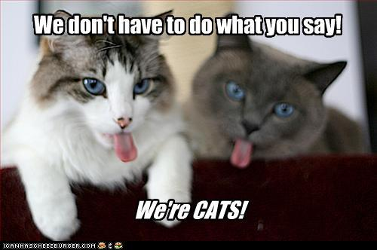

Slide 6
2. Can and be allowed to
Can and be allowed to: express permission
Can = more informal (spoken English)
You can have my car. I’ll stay at home.
Can I smoke here? – No, you can’t.
They aren’t allowed to leave the school before the bell rings.
Are we allowed to use a calculator for the mathematics test?

Slide 8
3. Should, ought to and must
Should and ought to: express mild obligation, suggestion, advice
= often used with “I think….”, “I don’t think….”
You always have bad results. I think you should study more.
You ought to be more careful with mother’s car.
Do you think I should go on a diet?

Slide 9
Must: strong obligation that involves the speaker’s opinion = rather personal (⬄ have to)
You must visit your grandfather.
I must get my hair cut.
Must: also used in formal, written style
All visitors must leave the premises before 12 o’clock.
Books must be returned before the due date.

Slide 10
4. Making requests : can, could, will and would
Examples:
Can/could/Will/Would you help me, please?
Would you mind helping me, please?
Can/Could I ask you a question?
Do you mind if I close the door?
Would you mind if I closed the door?

Slide 12
Can: more familiar
Could: more formal
Ways of responding to requests :
Excuse me! Could you help me?
- Sure. / Of course.
- Well, I’m afraid I’m rather busy now.
Would you mind if I opened the door?
- No, not at all. / No, that’s fine.
- Well, I’m a little cold, actually.

Slide 13
5. Making offers : will and shall/should
‘ll : for an intention, a decision, an offer made at the moment of speaking
- Give me that suitcase. I’ll carry it for you.
- Let’s go to the pub. I’ll buy you a drink.
Shall/Should : in questions with the first person singular or plural to express an offer, a suggestion, a request for advice
- Shall we go to the theatre at the weekend?
- Shall I close the window?
- What should we have for lunch?
- Shall we do some exercises now?

