Slide 1
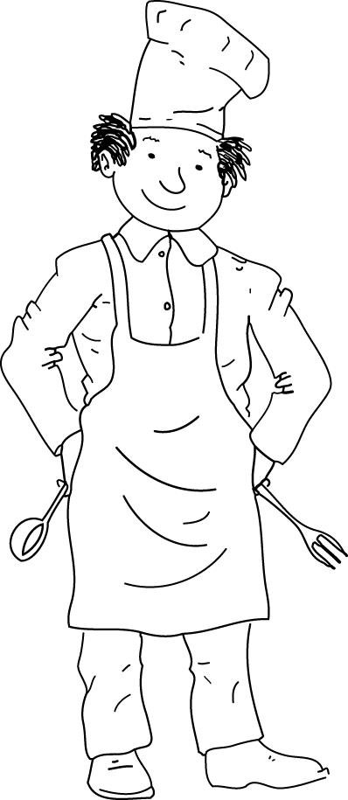
FOOD (3)

Slide 2
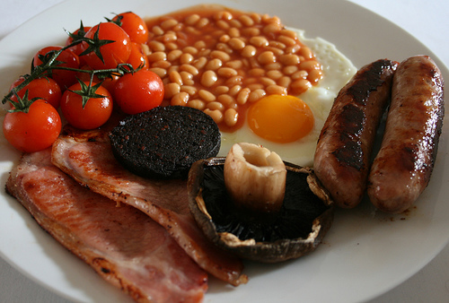
English breakfast

Slide 3
1. tea

Slide 4
2. coffee

Slide 5
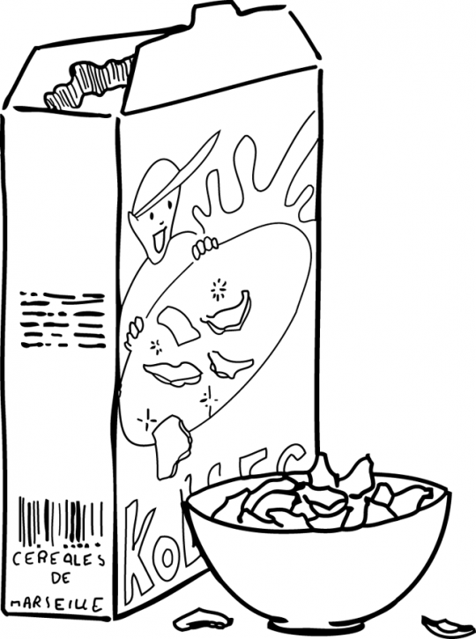
3. cereals

Slide 6
4. orange juice / fruit juice

Slide 7
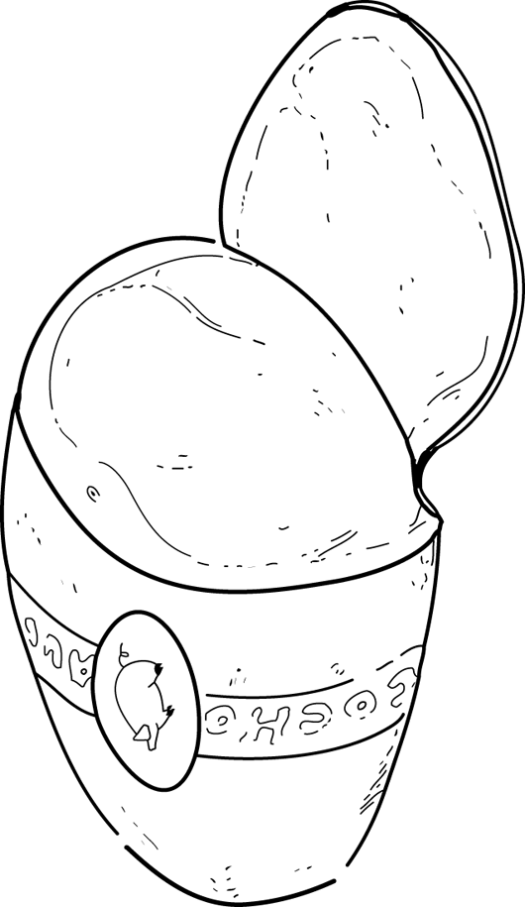
5. bacon

Slide 8
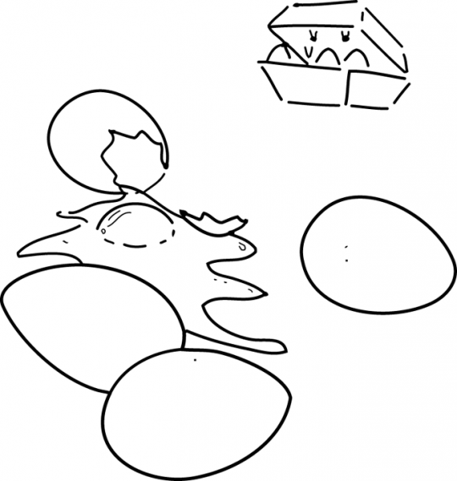
6. eggs

Slide 9
7. bacon and eggs

Slide 10
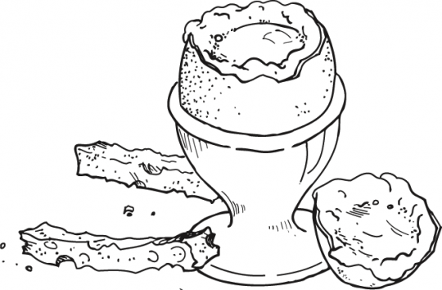
8. boiled egg

Slide 11
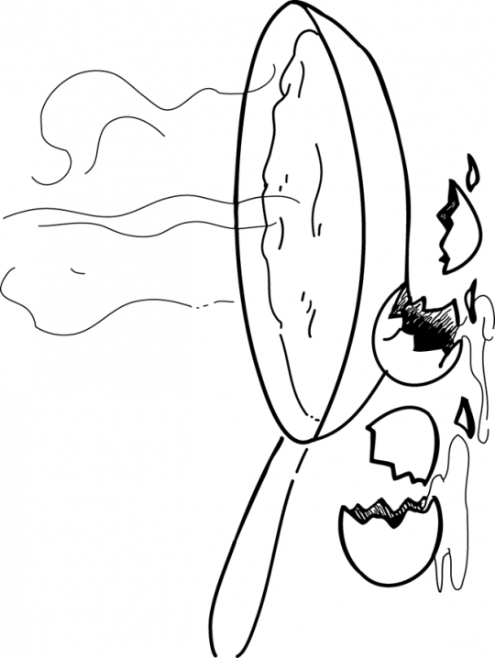
9. scrambled egg

Slide 12
10. sausages

Slide 13
11.croissants

Slide 14
12. baguette / French bread

Slide 15
13. (a loaf of) bread

Slide 16
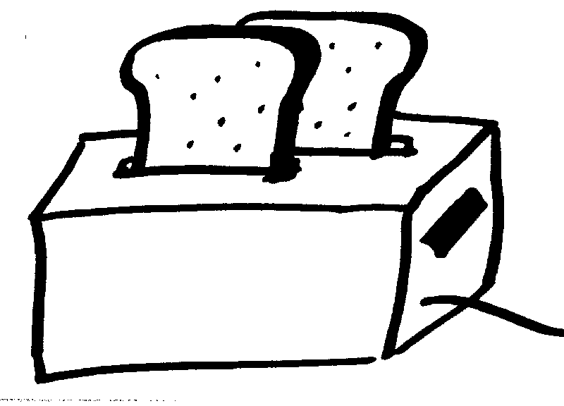
14. toast

Slide 17
15. butter

Slide 18
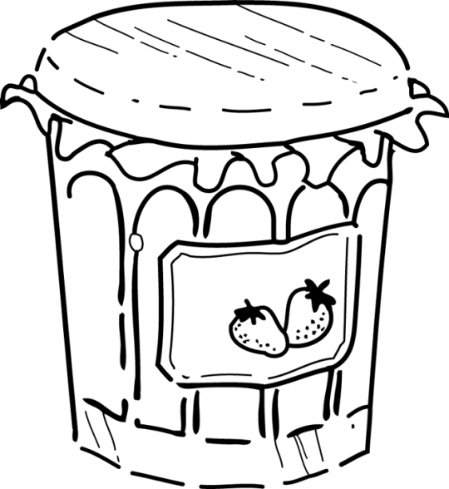
16. marmalade

Slide 19
17. cheese

Slide 20
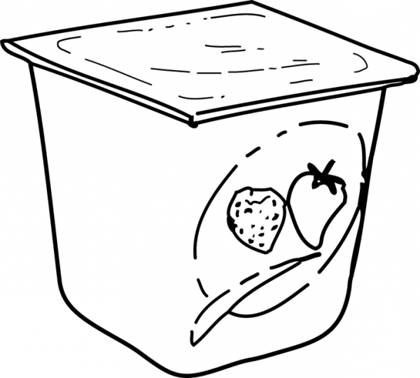
18. yoghurt

